Slide 1
Instructions
December 12, 2019

Slide 2
Welcome
This is an experiment in decision making.
Your earnings depend on decisions you make as well as the decision of the Player you are paired with.
If you have questions at any time, please raise your hand and a monitor will come to help.

Slide 3
Payouts
The experiment is composed of several Matches.
Each Match has many Periods.
You will earn Income every Period. All Income is placed into your Bank Balance.
The more money in your final Bank Balance at the end of each Match, the more you will be paid in US Dollars.

Slide 4
Matching
In this experiment, there are two types of Players: A and B.
You will be the same type for the entire experiment.
Each Match, Player A and Player B are paired up. You will be paired with a different person each Match.

Slide 5
Territory Income
In each Match, there is Territory.
You control some Territory. Territory not under your control is controlled by the Player you are paired with.
The more Territory you control, the higher your income.

Slide 6
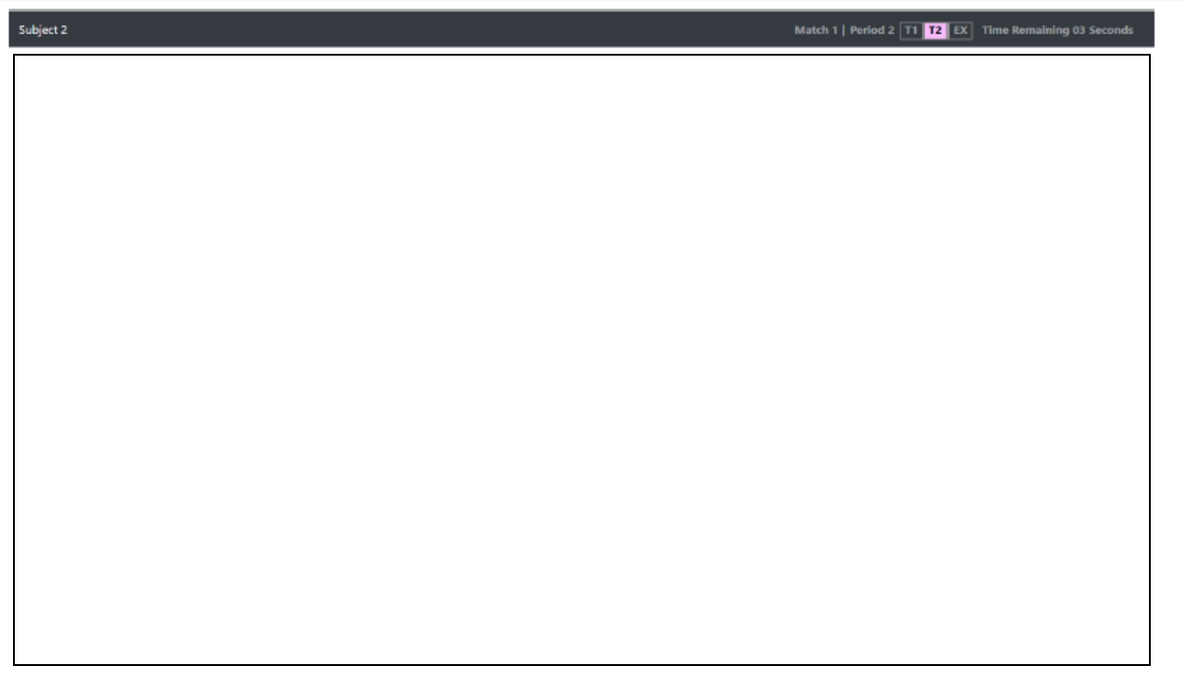
This is your screen.

Slide 7
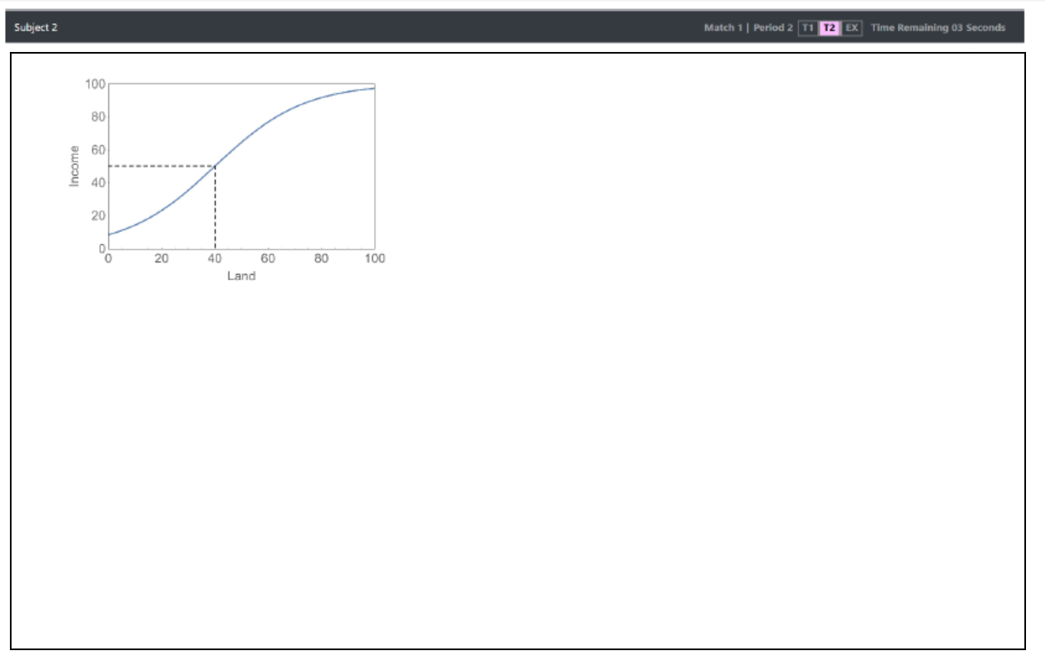
The dotted line shows your current Territory and Income.
This graph shows how much Income you receive based on the amount of Territory you control.

Slide 8
Territory Expansion
Each Period, you may spend from your Bank Balance to perform Expansion.
The more you spend, the higher your Expansion for the Period. (Potential expansion!)
Territory changes depending on how much each Player Expands

Slide 9
Expansion Example
Suppose you control 40 Territory and perform 5 Expansion this Period.
Example 1: The other Player Expands by 2. Next Period, you will control 40 + (5 - 2) = 43 Territory.
Example 2: The other Player Expands by 5. Next Period, you will control 40 + (5 - 5) = 40 Territory.
Example 3: The other Player Expands by 8. Next Period, you will control 40 + (5 - 8) = 37 Territory.

Slide 10
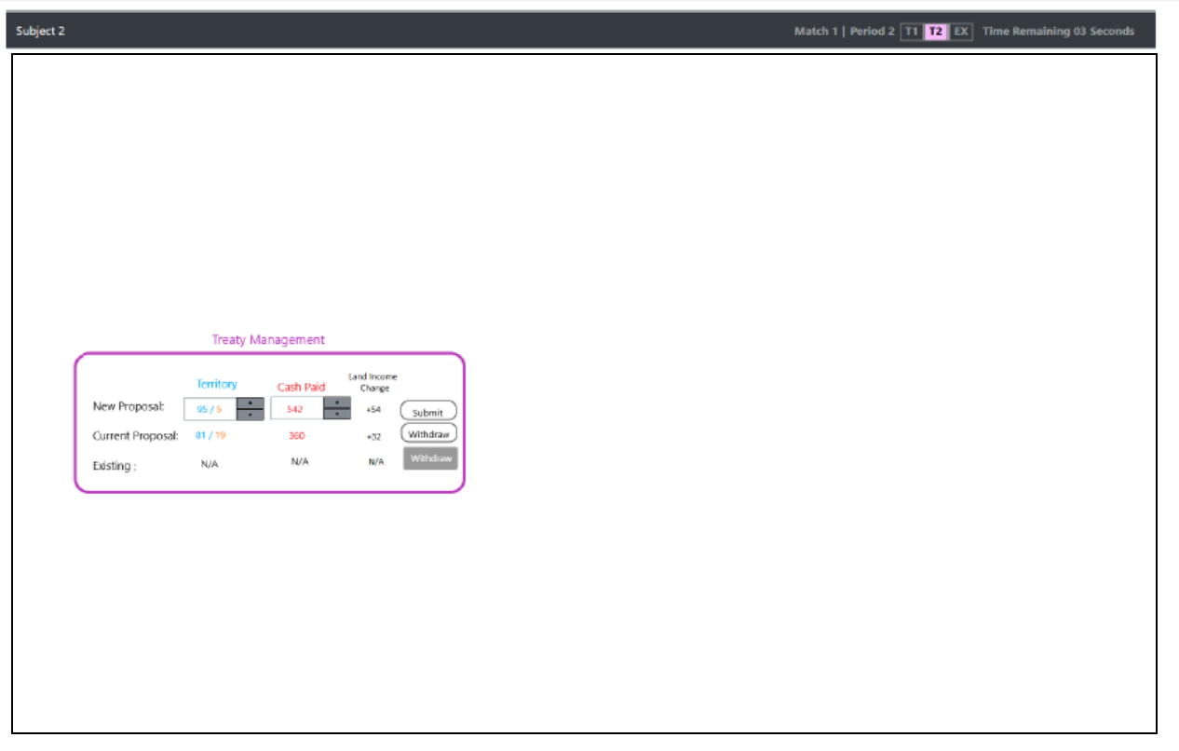
When Treaty Management window is activated, you will be able to prepare, submit or withdraw a proposal.

Slide 11
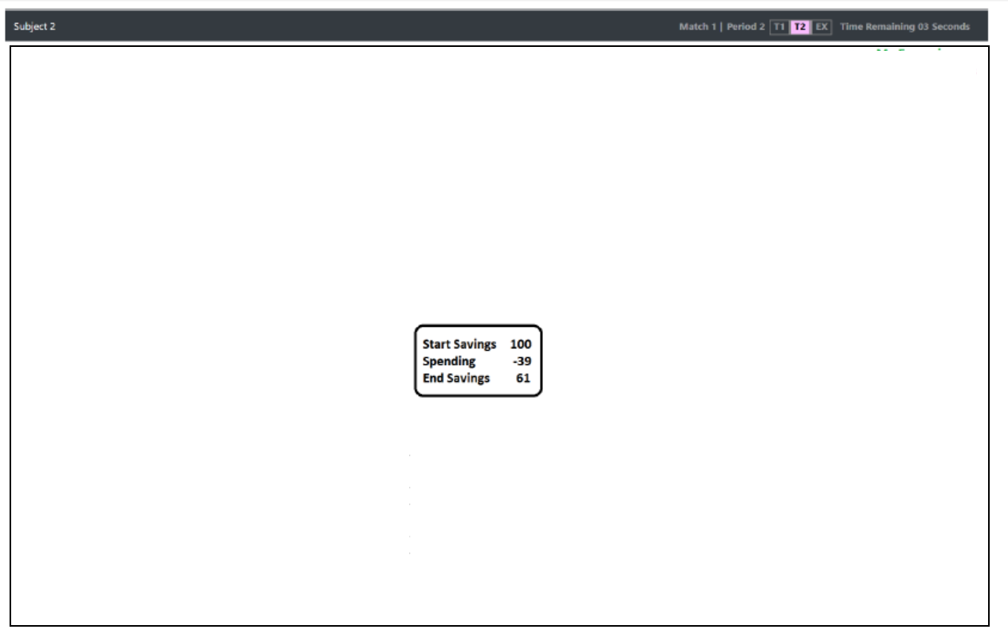
Bank Balance Information
This will let you know your current balance and deducts the amount you expect to spend on territory management. It will update as you adjust your spending.

Slide 12
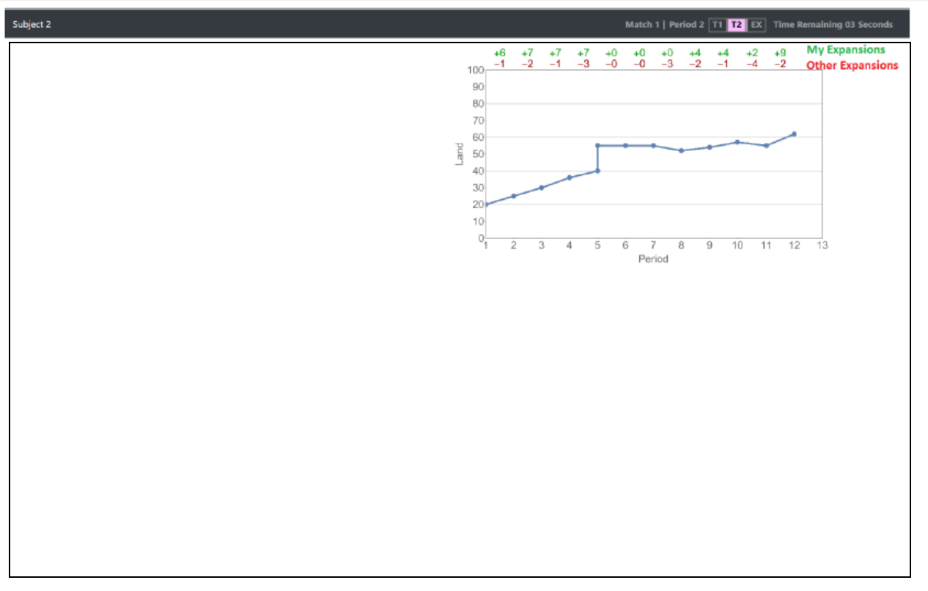
Keeps track of each players’ expansion history.
You started with 20 Territory. At the end of match 1 you expanded to 25 (+6, -1 indicated on top), etc.
Blue line shows the territory you control in each period.

Slide 13
Treaties
Each Period, Player A may propose a Treaty, and Player B may accept, reject, or ignore the Treaty.
Treaties have parts: a proposed Territory split, and a Payment.
If Player B accepts a treaty, the territory is reallocated according to the Treaty terms, and Player A pays Player B the amount offered.
Players may not Expand the same Period the Treaty is accepted.
Either Player may Expand in future Periods.

Slide 14
When Treaty Management window is activated, you will be able to prepare, submit or withdraw a proposal.

Slide 15
When Treaty Management window is activated, you will be able to accept or reject a proposal made by the other player.

Slide 16
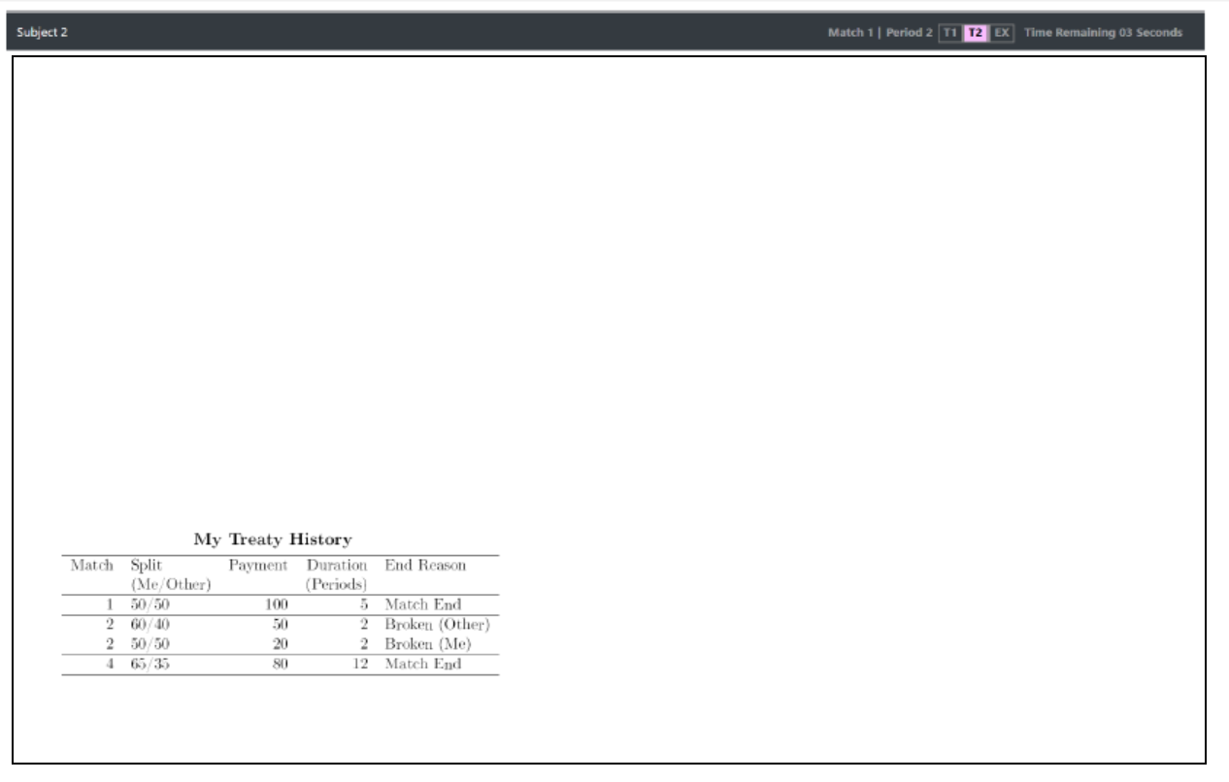
This table will be updated at the end of each match (scroll to see history beyond 4 matches).

Slide 17
Defensive Spending
When spending on Expansion, you may choose to enact Defensive spending.
Defensive spending works the exact same as normal Expansion, with 2 differences.
1. If you Expand more than the other player you will gain 0 Territory.
2. Defensive Spending will not end a Treaty.

Slide 18
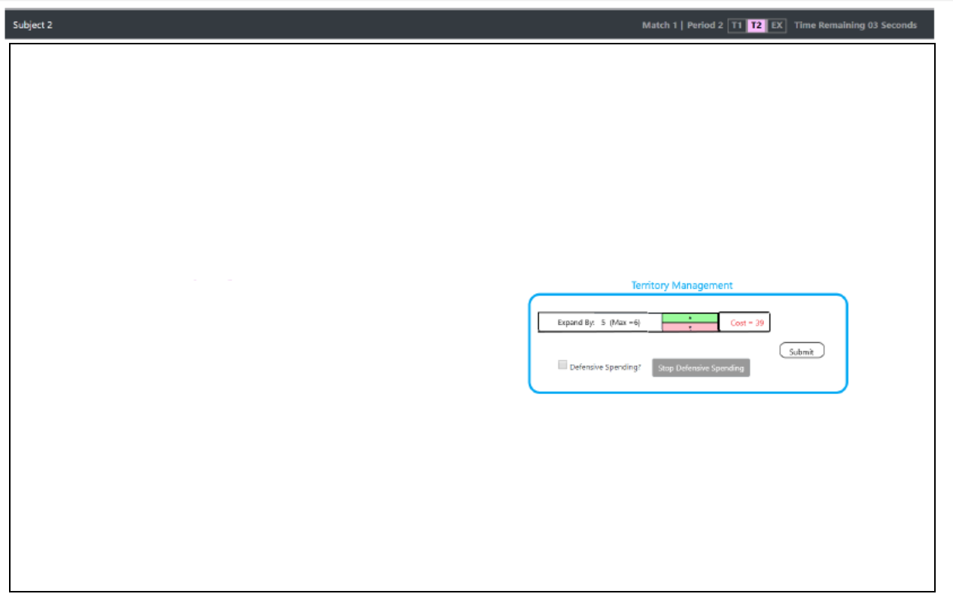
When you in T2, you will be able to do territory management where you can expand by 6% max at a proposed cost. The cost will be deducted from you Bank Balance.

Slide 19
Order of Periods
Each Period is split into three parts:
1. Treaty Proposal—Player A may propose a Treaty
2. Treaty Evaluation—Player B may accept, reject, or ignore the Treaty (if any).
3. Expansion—Both Players decide how much to Expand (unless a Treaty was accepted this Period).

Slide 20
End of Match
Each Match will last for a minimum of N Periods.
After the first N Periods, the Match may randomly end after each Period.

Slide 21
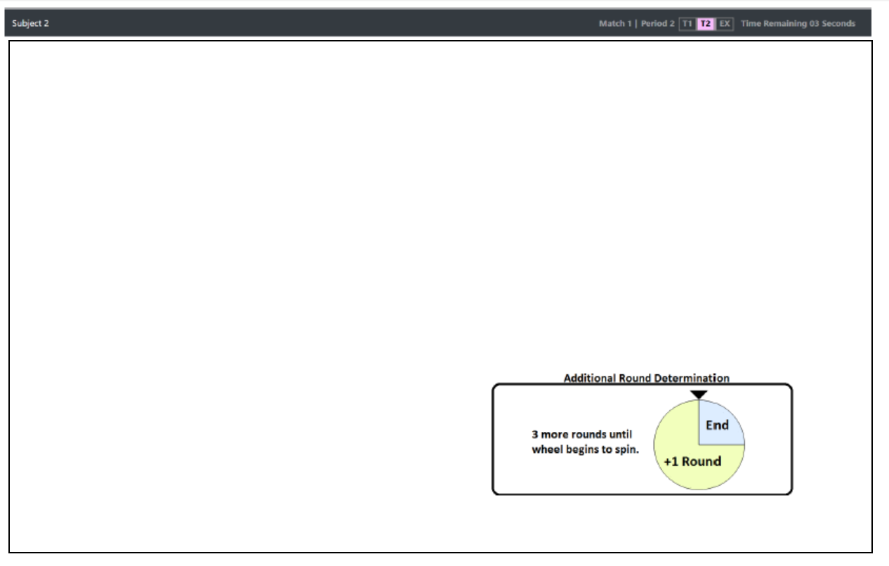
The wheel will spin after you complete N matches. You will have a 25% chance of the game ending (see blue area).

Slide 22
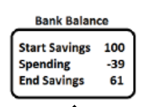
Summary
You will repeat the experiment multiple times and be paired with different players.
Each Match can last a minimum of N periods
You will carry your Bank Balance Savings between matches
You will have a new starting Bank Balance at the start of each round with new starting land allocation.

Slide 23
The End

